Slide 1

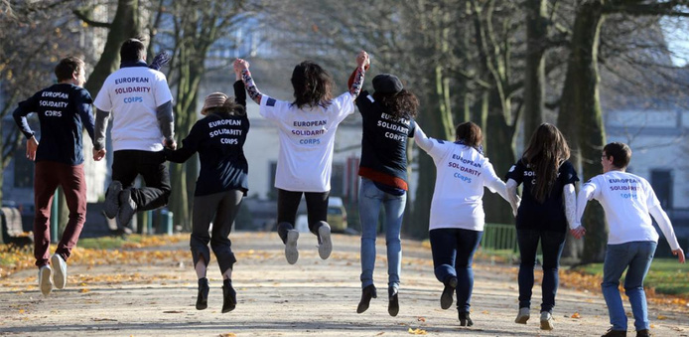





Ambassadors of Europe and mobility

Slide 2
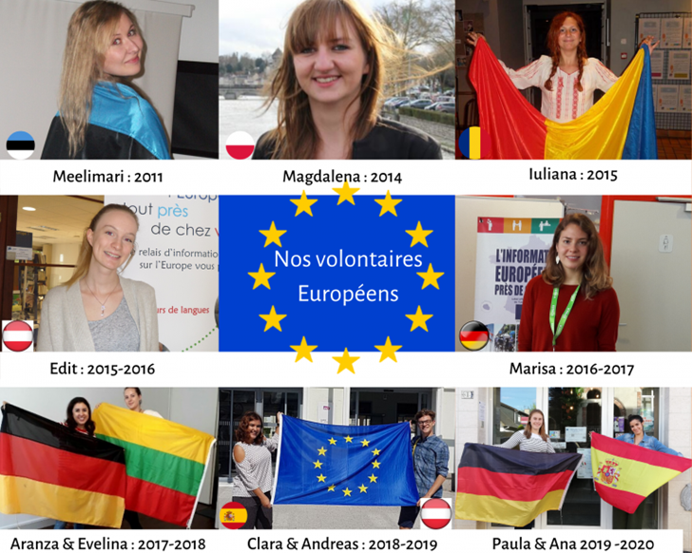
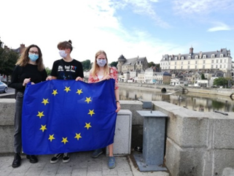
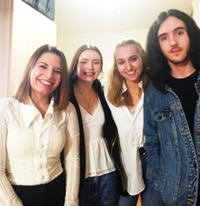
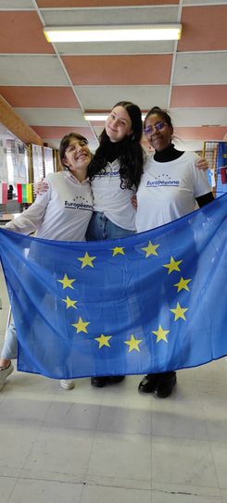
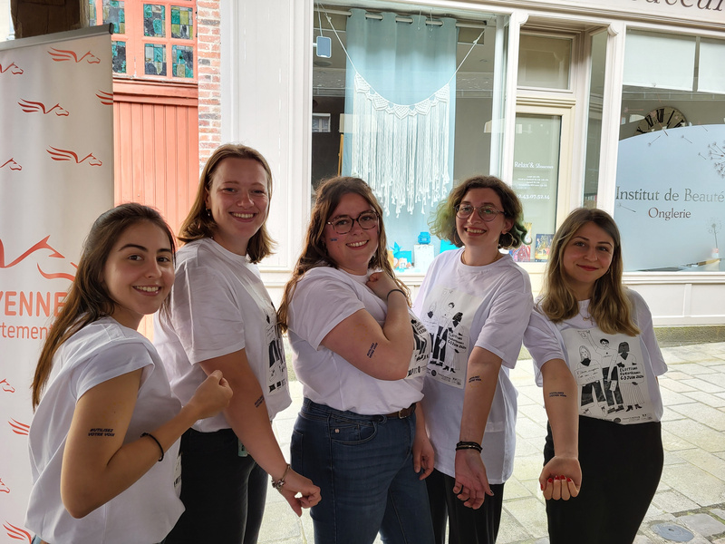
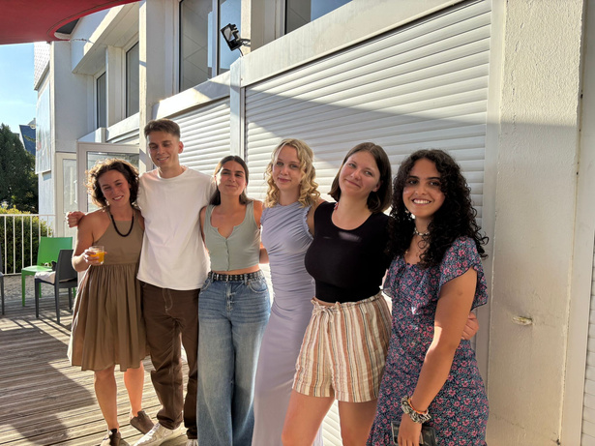
Our previous Ambassadors of Europe and mobility
2011 : Meelimari (Estonia)
2014 : Magdalena (Poland)
2015 : Iuliana (Romania)
2015/16 : Edit (Austria)
2016/17 : Marisa (Germany)
2017/18 : Aranza (Germany), Evelina (Lituania)
2018/19 : Clara (Spain), Andreas (Austria)
2020/21: Sarah (Ireland), Aileen (Germany), Doortje (Netherlands)
2021/22 : Fani (Greece), Ziede (Lituania), Lea (Germany), Vicente (Spain)
2022/23 : Paola (Italy), Alina
(Austria), Carla (Italie)
2023/24 : Josefina (Spain), Sarah
(Germany), Melita (greece),
Irem (Turkey)
2024/25 : Giulia (Italy), José (Spain), Alba (Spain), Jytte (Germany), Luca (Hungary), Elena (Italie)

Slide 3

What we’re looking for 2026/2027
6 volunteers:
  Two at : La Maison de l’Europe en Mayenne - Europe Direct, Laval
  One at: Habitat Jeunes, Laval
  One at: L’Iliade Habitat Jeunes, Château-Gontier
  One at : Maison Familiale Rurale Craon Oudon
  One at : Don Bosco High School, Mayenne

Slide 4
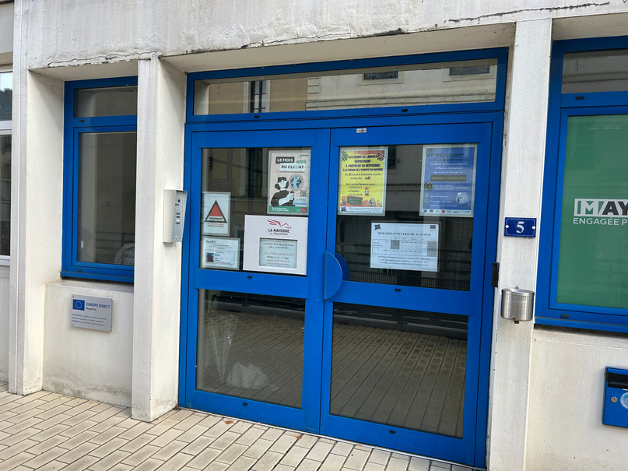
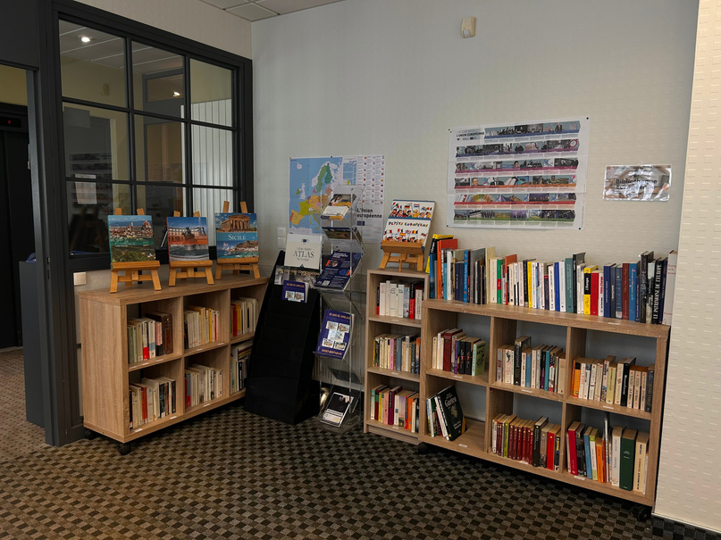
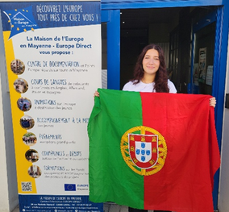
1. La Maison de l’Europe en Mayenne - Laval
  European Documentation Centre and Library
  Animations and trainings on the EU
  Conferences and debates on current European affairs
  European events
  Language courses
  Support for young people in their mobility
  Support for European project leaders
Beatriz (Portugal), volunteer 2025/2026

Slide 5
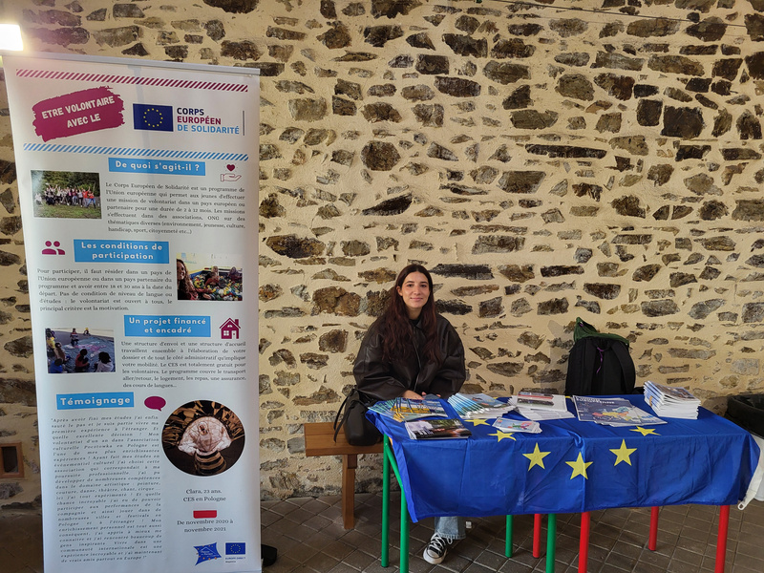
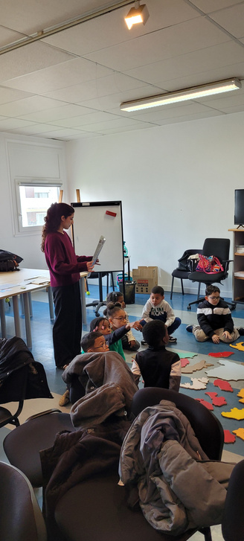

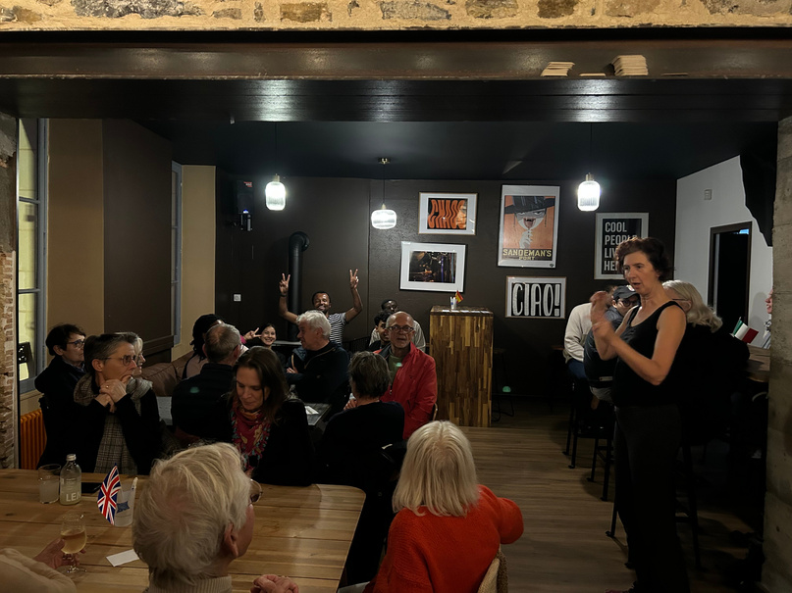
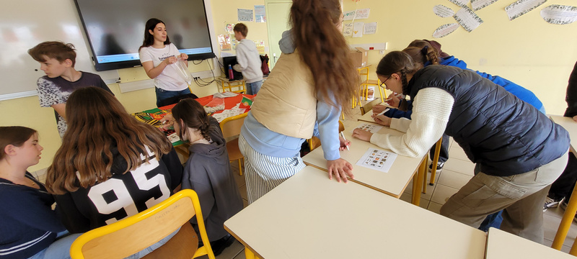
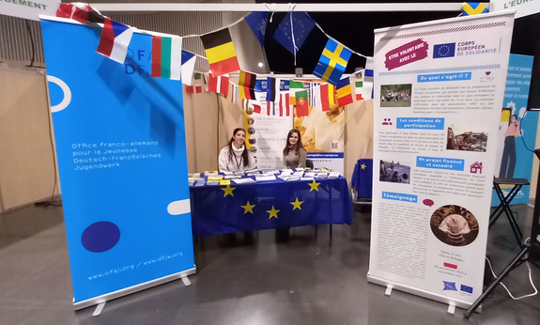
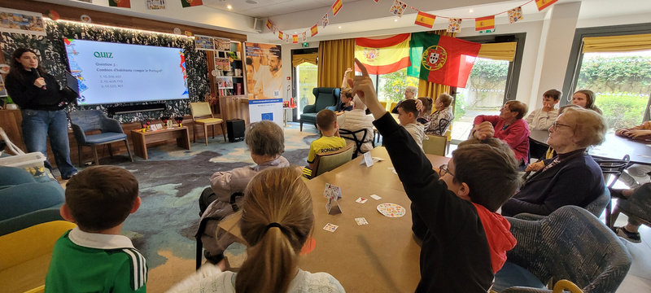
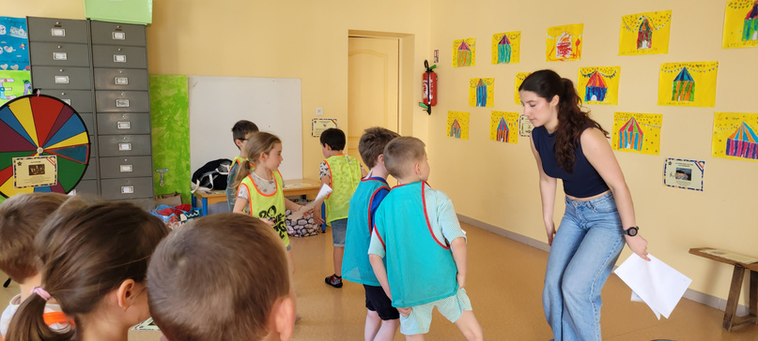
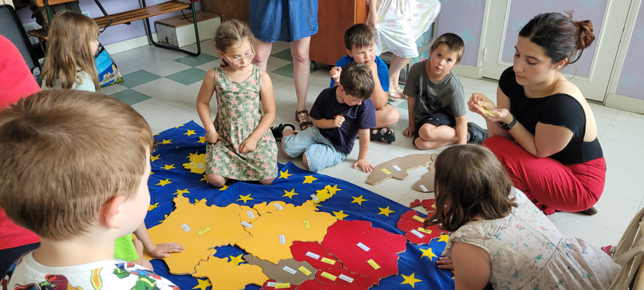
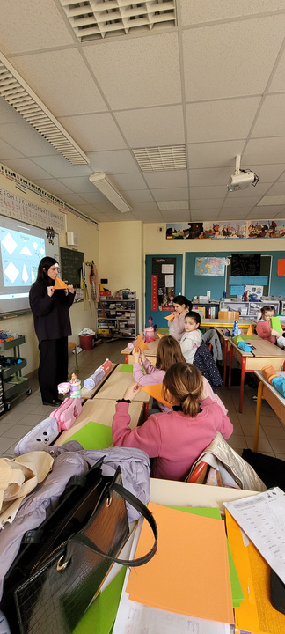
Your project : Ambassador of Europe and Mobility
Beatriz’ testimony
“On a daily basis, I helped with the visuals for the social media and the animations, for example doing: powerpoints, rallyes, flyers, etc. During the week I would also work with the kids, teaching them about the EU and doing some animations with them. Every month I organized the Café des Langues, having a great time with different people and learning new languages. Had the opportunity of sharing my experience with young people, explaining all types of options to go abroad, and also getting to present my country to others.”

Slide 6
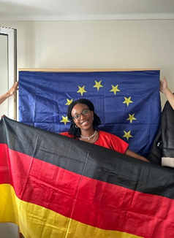
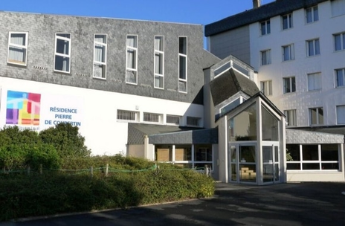
2. Habitat Jeunes Laval - Résidence Pierre de Coubertin
Janane (Germany), volunteer in 2025/2026
Habitat Jeunes Laval was founded in 1967, and its aim is to provide a structure for welcoming, animating, informing and guiding young people in their social, cultural and professional life. It offers accommodation for 16-30 year olds, group activities, a catering service open to all, and individual support in its three residences in Laval.

Slide 7
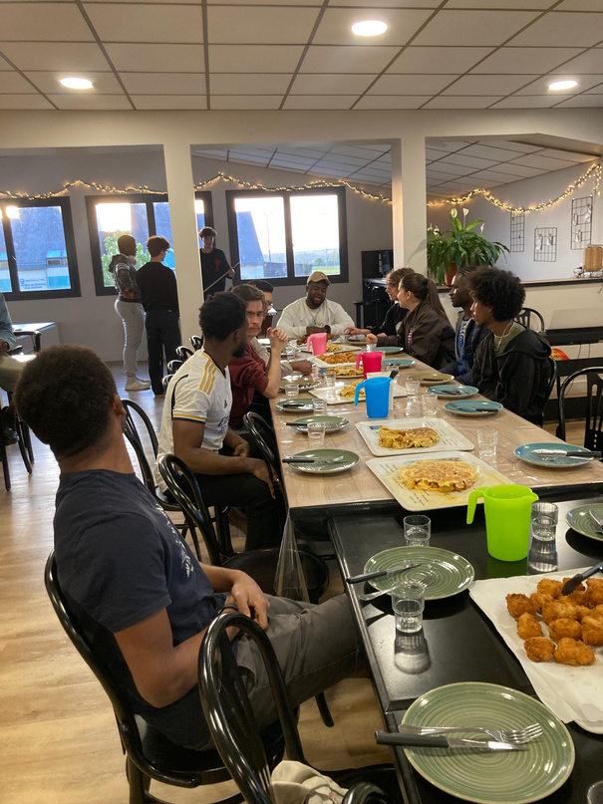
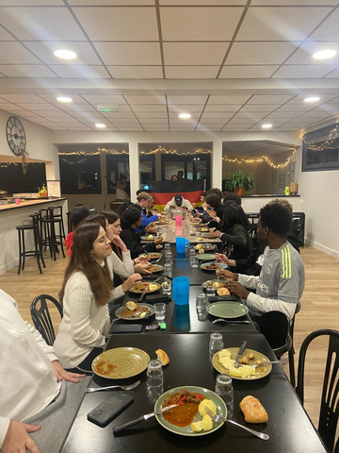
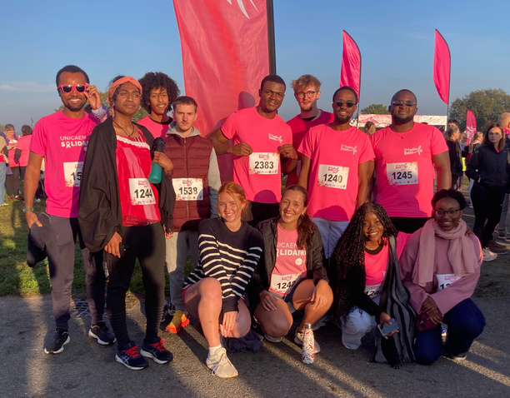
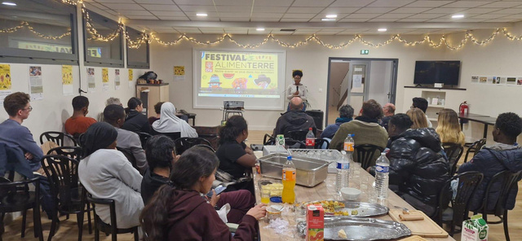
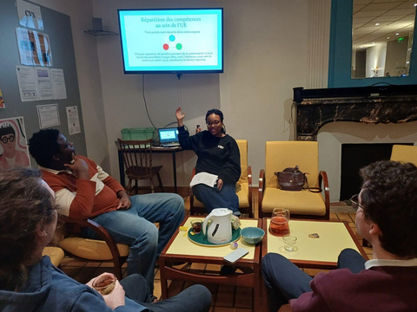
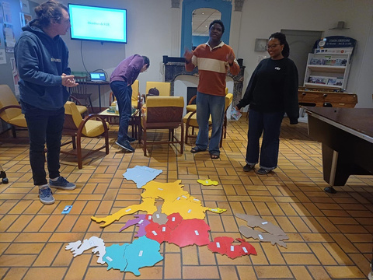
Your project : Group times for living together
Janane’s testimony
“I’m doing my voluntary service at the Pierre de Coubertin residence run by Habitat Jeunes. Young people from all over the world live there – from Brazil, China, the Ivory Coast… – and they come from a variety of professional and educational backgrounds.
My role is to organise events and activities for the residents to encourage a sense of community.”

Slide 8
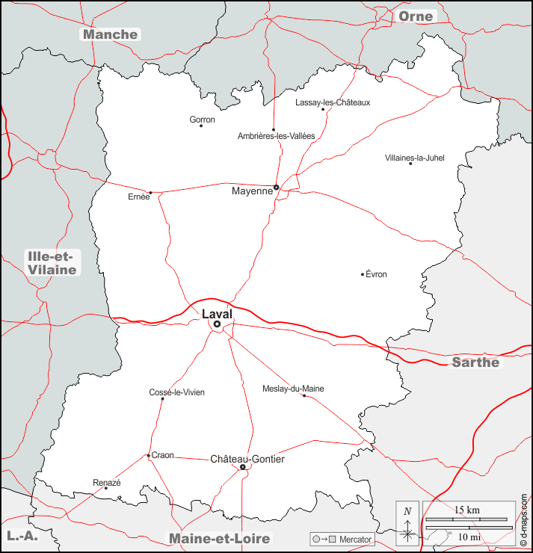
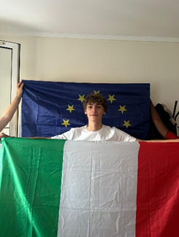
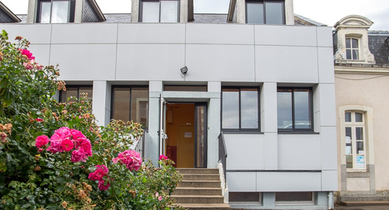
3. MFR Craon Oudon - Craon
Maison Familiale Rurale = rural middle and high school with general classes and vocational trainings
  Accompany teachers in lessons (mainly english and geography)
  Teach the students about your country and the EU + organize afternoons dedicated to these topics and promote European mobility
  Support the students with creative projects, cooking etc.
  Research for Erasmus+ projects, designing posters for activities etc.
  Take part in events and projects by the Maison de l’Europe en Mayenne (Soirée de Noël, Fête de l’Europe etc.)
Gioele (Italy), volunteer in 2025/2026

Slide 9
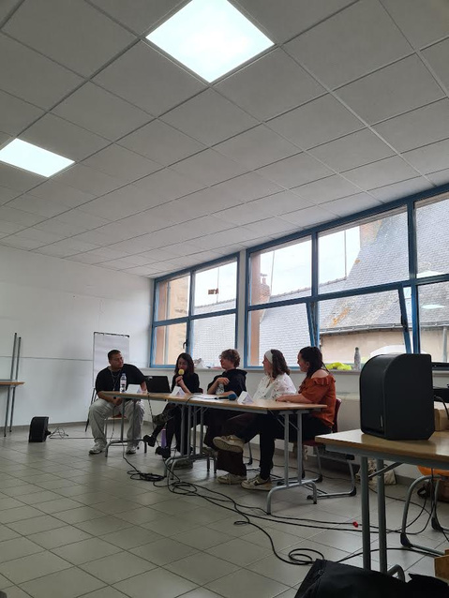
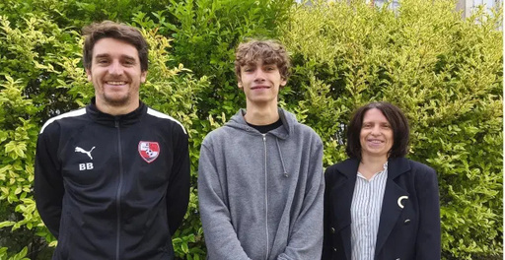
Your project : Ambassador of Europe and Mobility
Gioele’s testimony
“I am volunteering at the MFR in Craon, where I help the teaching staff supervise students during activities and lead activities designed to showcase opportunities and promote the values of the European Union.
This experience has allowed me to acquire new skills, starting with learning French, but also to understand how the French school system works.”

Slide 10
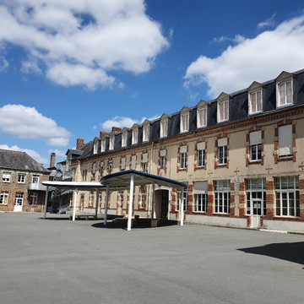
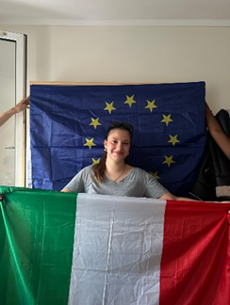
4. Don Bosco High School - Mayenne
The DON BOSCO School Unit brings together three nursery and primary schools, a middle school, a general education high school, a vocational high school and a vocational training center.
There are around 1,950 young people that we support on a daily basis. The courses last 50 minutes, so we capitalize on time at the end of the day to allow young people to benefit from personalized support (help and support, in-depth study, work on orientation, help with personal work, etc.) and the practice of activities (artistic and cultural, religious, sports, professional: CV, job interview, etc.).
Anita (Italy), volunteer in 2025/2026

Slide 11
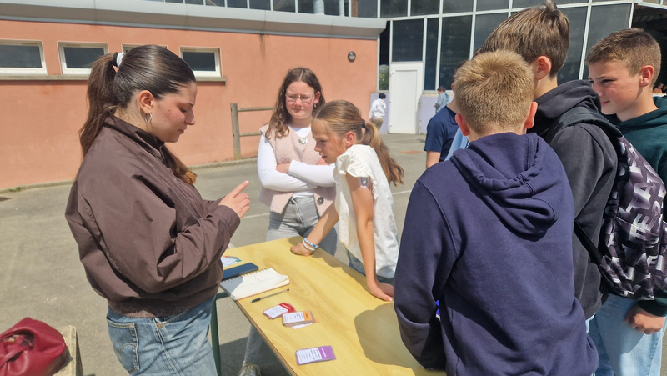
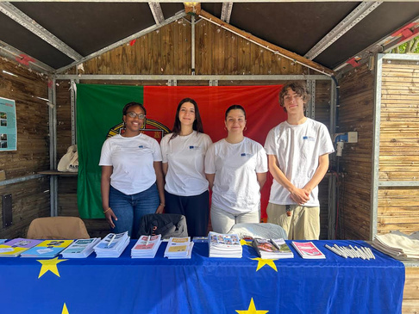
Your project : Ambassador of Europe and Mobility
Anita’s testimony
“ I work mainly with high school students, but sometimes with middle school students as well. During the school day, I assist a teacher in the classroom, helping students primarily with their English studies.
On occasion, I also organize activities related to Europe to help young people learn more about the different cultures, countries, and opportunities it offers.”

Slide 12
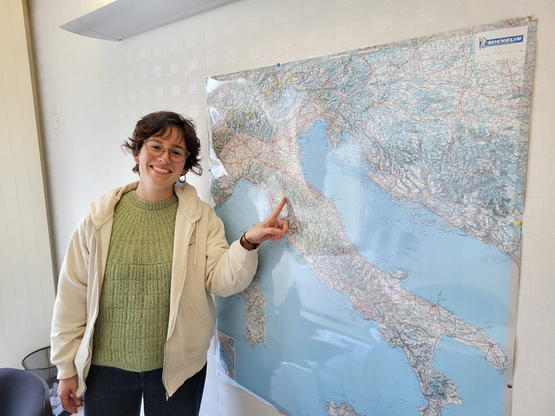
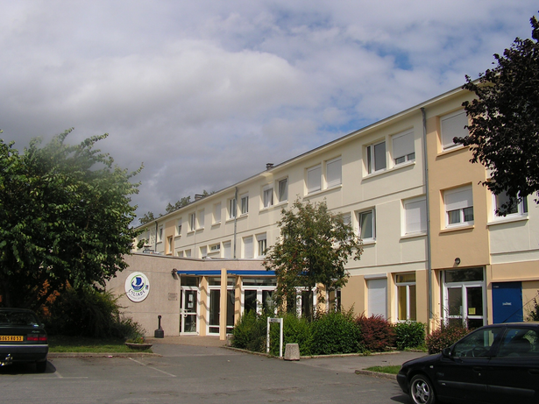
5. L’Iliade Habitat Jeunes - Château-Gontier
Giulia (Italy), volunteer in 2024/2025
L’Iliade Habitat Jeunes is an organization dedicated to welcoming, animating, informing and guiding young people in their social, cultural and professional life. It offers accommodation for 16-30 year olds, group activities, a catering service open to all. The volunteer in L’Iliade, has a private room for them in the residence in Château-Gontier

Slide 13
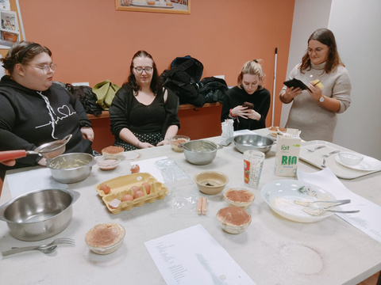
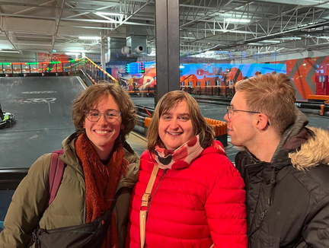
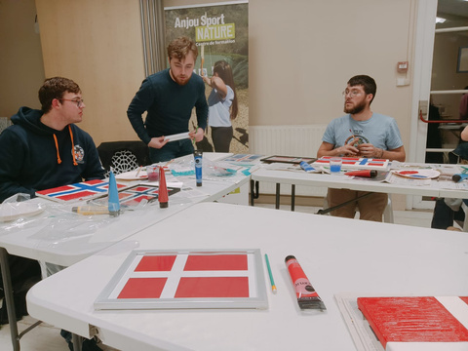
The projet: “À la découverte de l’Europe”
Giulia’s testimony
“My mission consists in explaining the European Union to young people through animations. I prepare the animation programme and I take part in the activities. We have dedicated each month to one country and, for each country, we have created posters and events for the residents and the canteen users.
I also participe in a project about health and women’s rights. Every month, I’m in charge of creating information posters and taking part in the activites with the youngsters. On March, because of Women’s Day, we have created posters with the interviews made to some women from town about their view on the topic of protection of women’s rights, comparing the situation in France to the situation in Italy.”

Slide 14
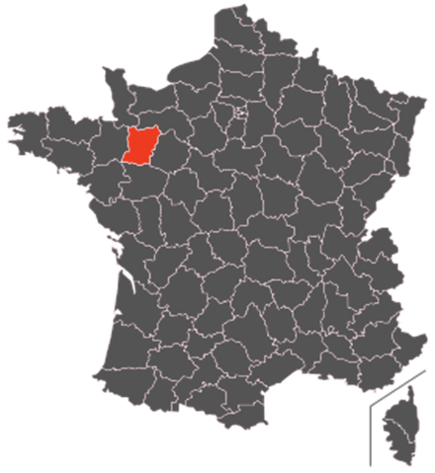



Where?
Région Pays de la Loire - Département de Mayenne - Laval

Slide 15
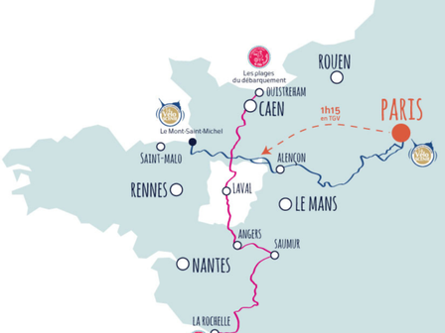
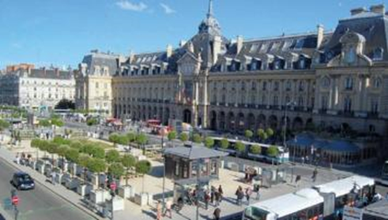
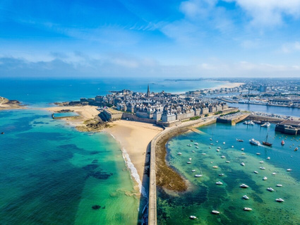
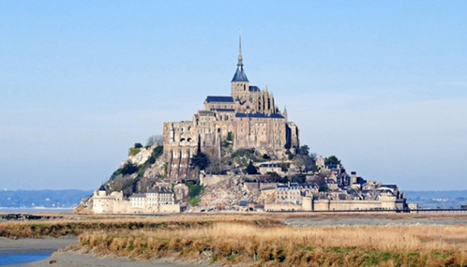
About Laval...
  Laval : 50000 inhabitants
  1h from Rennes, Angers and Le Mans
  1h30 by train from Paris
  1h30 from Saint Malo/ Cancale/ Dinard (charming cities on the coast) and le Mont Saint Michel (one of the most famous places in France)
Rennes
Saint Malo
Mont Saint Michel

Slide 16
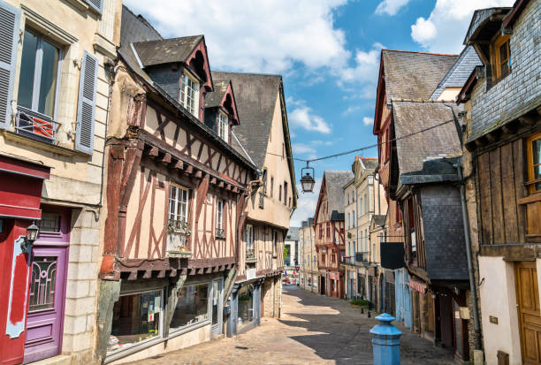
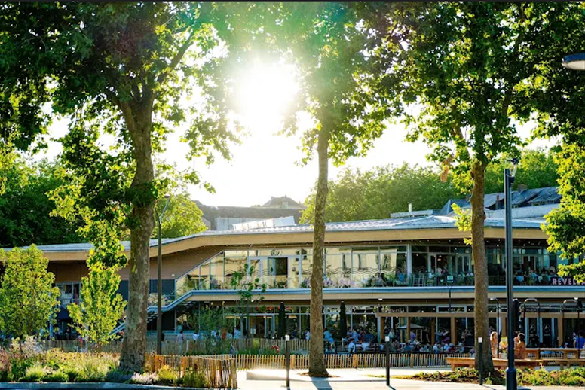
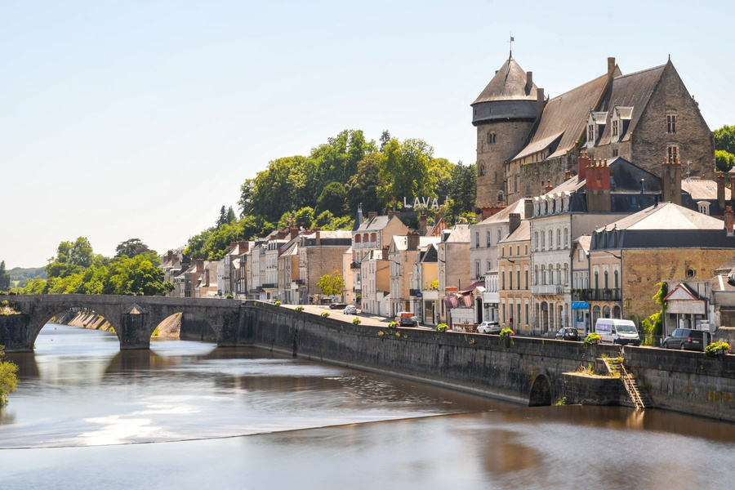
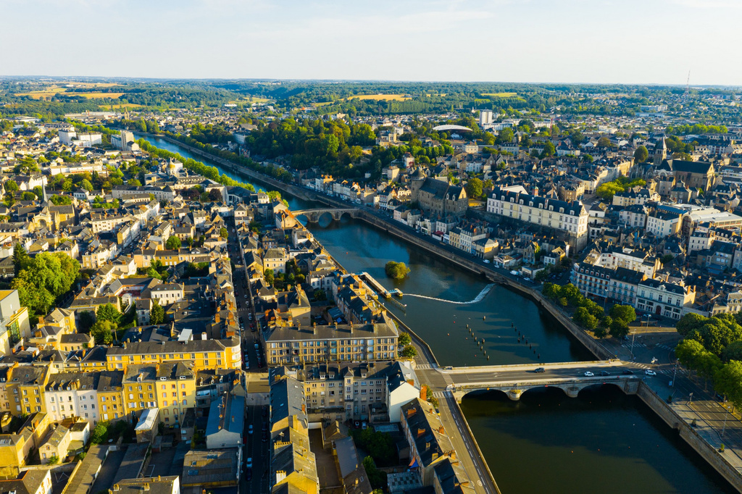
About Laval...
https://www.youtube.com/watch?v=YFHW_qOWsm4

Slide 17



About Laval...
cultural events
Festival les 3 éléphants
https://www.youtube.com/watch?v=YBfWIvZn-_I
Les lumières de Laval
https://www.youtube.com/watch?v=vDKbC267UAA
Festival le chainon manquant
https://www.youtube.com/watch?v=vDKbC267UAA

Slide 18

About the accomodation
Habitat Jeunes - Résidence Pierre de Coubertin
For young people aged between 16 and 30 (students, trainees, apprentices, volunteers, international language assistants...)

Slide 19



  No need to bring bed sheets, it is already included
  You need to bring towels
  There is a laundry room in the residence (5€ for washing and drying + getting the washing product)
  There are 2 appartments

Slide 20






Common rooms to spend time together with the other inhabitants of the residence
A canteen where you can eat breakfast, lunch or dinner for low prices
From Monday to Thursday : an animation every evening (dinner, sport evening, talking evening, paintball, museum, etc. for free.)

Slide 21

About the accomodation
L’Iliade Habitat Jeunes
For young people aged between 16 and 30 (students, trainees, apprentices, volunteers, international language assistants...)

Slide 22




  No need to bring bed sheets, it is already included
  You need to bring towels
  There’s a private room

Slide 23



Practical aspects
  We will provide you a SIM card
  In the first days, we will open a french bank account at “Crédit Mutuel” with you and you will get a french credit card
  You will receive pocket and food money at the beginning of each month by bank transfer

Slide 24

Financial aspects
  Depending on the distance your travel fees will be covered up to 395€ (or more) and even up to 535€ (or more) if you travel by train !!!
  Pocket money : 8€ per days (240€ per month) + food money (250€ per month) = 490€ per month

Slide 25
If you are interested...
send to the House of Europe the following documents :
  CV and motivation statement
  Scan of your ID card or passport
  Scan of your European Health Card
  Criminal record
contact : animation@maison-europe-mayenne.eu

